Slide 1
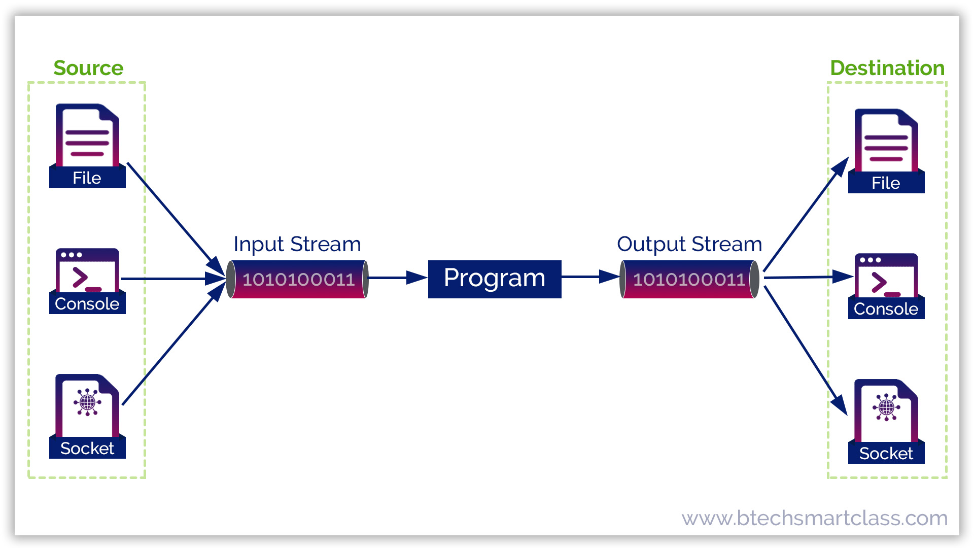

Write to File
Keyboard

Slide 2
Today
Quiz
After quiz read lecture and explore code

Slide 3
File Output
Currently you can use the System.out where System is the class name and out is an instance of the System class to access methods to print to the console
System.out.print("Enter the filename with no spaces and include .txt \n");
Now you will explore writing information to a file.
Java File Class is an abstract representation of file and directory pathname. A pathname can be either absolute or relative.
Java PrintWriter class is used to print the formatted information to a file output stream.

Slide 4
File Class
Why Files
Data stored in variables is temporary – goes away when program ends
Files give a way to preserve values after program exists
Purpose
The File Class provides an abstraction
Deals with most of machine-dependent complexities of files and path names
Wrapper for the filename and its directory path
What it is
Contains the methods for
Obtaining file and directory properties
Renaming and deleting files and directories
File name is a string
What it Is Not
Does not contain the methods to
Create a file
Read data from a file
Write data to a file
To perform I/O, we need to create objects using appropriate Java I/O classes

Slide 5
Files and File Paths
Absolute file name: filename with its complete path and drive letter that is machine dependent
On windows you might have something like:
C:\dev\testFile.java
On Unix or Mac you might have something like:
/home/dev/testFile.java
Relative file name: File name is in relation to the current working directory that is Machine independent
File name is in relation to the current working directory
Complete directory path is left off
testFile.java is a relative file name
Usually better to not use absolute file names in your program since they will not work on other platforms
The following will get absolute filepath of where the file is located on the computer
String absoluteFilePath = gradeFile.getAbsolutePath();

Slide 6
Steps for Writing to a File
Import File, IOException and IOException classes
import java.io.*;
Any method that uses a PrintWriter object must have a throws IOException clause in its method header. You will learn more about this later.
public static void main(String[] args) throws IOException
Create a File object and pass the name of the file as a string.
String filename = “file.txt” File gradeFile = new File(filename);
Create a PrintWriter object by passing the name of the file
PrintWriter outputFile = new PrintWriter(gradeFile);
Use the PrintWriter class’s print and println methods to write data to the file. outputFile.println("\nCategories and percentage weights");
When finished writing to the file, you use the PrintWriter class close method to close the file.
outputFile.close();

Slide 7
Steps for writing to File
Create a File instance using reference variable filename that will refer to a file called grades.txt on your hard drive
File gradeFile = new File("grades.txt");
Create a PrintWrite instance using reference variable resultsFile that will be used to write data to the fileName reference variable that will connect to the shapes.text file.
PrintWriter outputFile = new PrintWriter(gradeFile);
Use the instance variable to access a public method printf to print formatted data.
outputFile.println("\nCategories and percentage weights");
You can get the absolute path to see where the file is located
gradeFile.getAbsolutePath()
Always remember to close the file
outputFile.close();

Slide 8
Preparation
Download, import FileWriteDemo2.java and explore
Enjoy Spring Break but spend some time on your GE04 Technical documentation

